Slide 1
Crime throughout the year vs. crime during the holidays.
Team: I don’t want no data scrub.
Rusty Gentile
Minal Jajoo
Scott Nubar
Axander Wilson

Slide 2

Synopsis
New Years Day | 1/1/2016
Martin Luther King Day | 1/18/2016
Super Bowl | 2/7/2016
Valentine's Day | 2/14/2016
Easter | 3/27/2016
Earth Day | 4/22/2016
Mother's Day | 5/8/2016
Memorial Day | 5/30/2016
Father's Day | 6/19/2016
Independence Day | 7/4/2016
Labor Day | 9/5/2016
Halloween | 10/31/2016
Veteran's Day | 11/11/2016
Thanksgiving | 11/24/2016
Black Friday | 11/25/2016
Cyber Monday | 11/28/2016
Hanukkah | 12/23/2016
Christmas | 12/25/2016
New Year's Eve | 12/31/2016
View crime throughout the year of 2016 and measure it against crime that only occurred during the holidays.
Hypothesis
There is a relationship between an increase in crime through out the year during major shopping holidays.

Slide 3
Questions
Is there an increase in crime during major shopping holidays?
Do cities with the least amount of crime experience an increase in crime that is more than noticeable during major shopping holidays?
Which holiday does crime more frequently occur?
Which crimes are more prevalent during major shopping holidays?
Do the holidays have an impact on crime location?

Slide 4

Crime Categories
Crime key
ASSAULT
RAPE
THEFT
ARSON
ATTEMPT
DRUG OFFENSE
BURGLARY
MOTOR VEHICLE THEFT
FRAUD
MURDER
THEFT
MISC

Slide 5
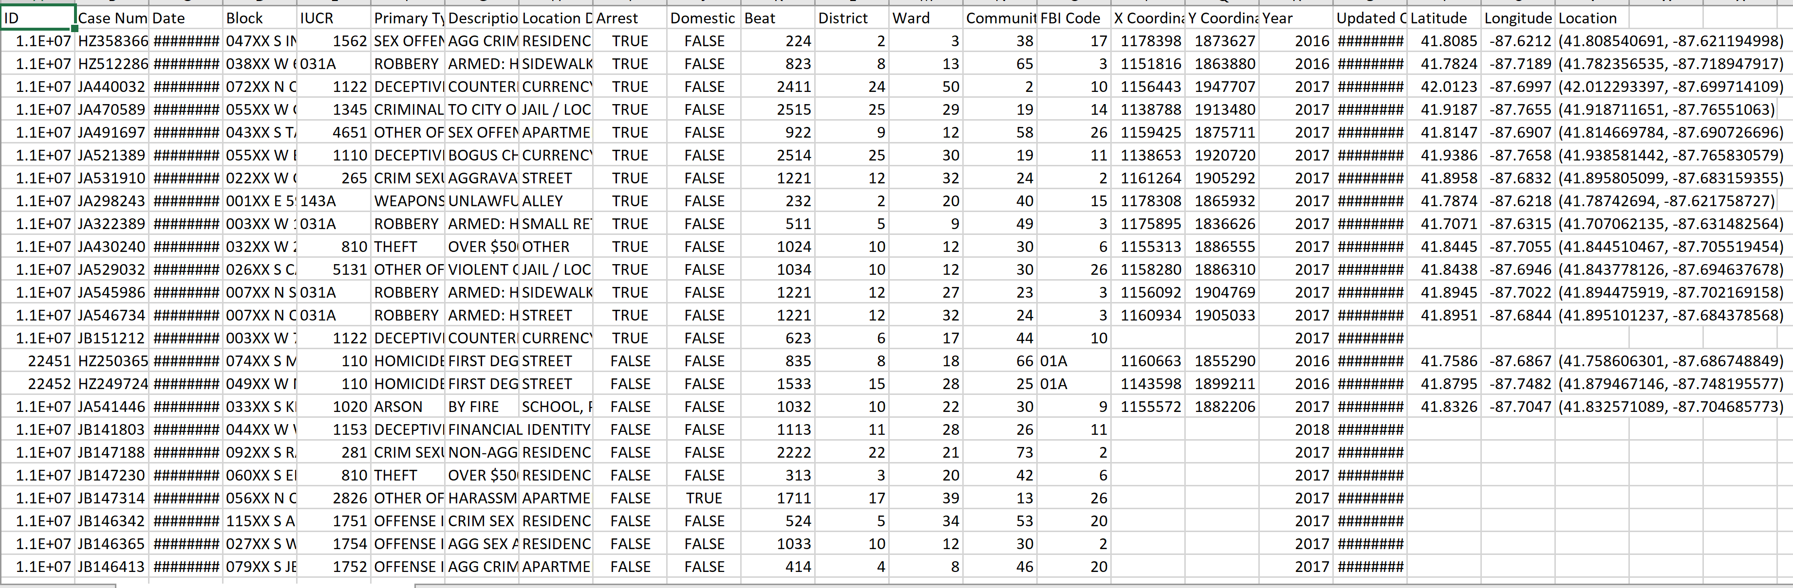
Sample Raw Data

Slide 6
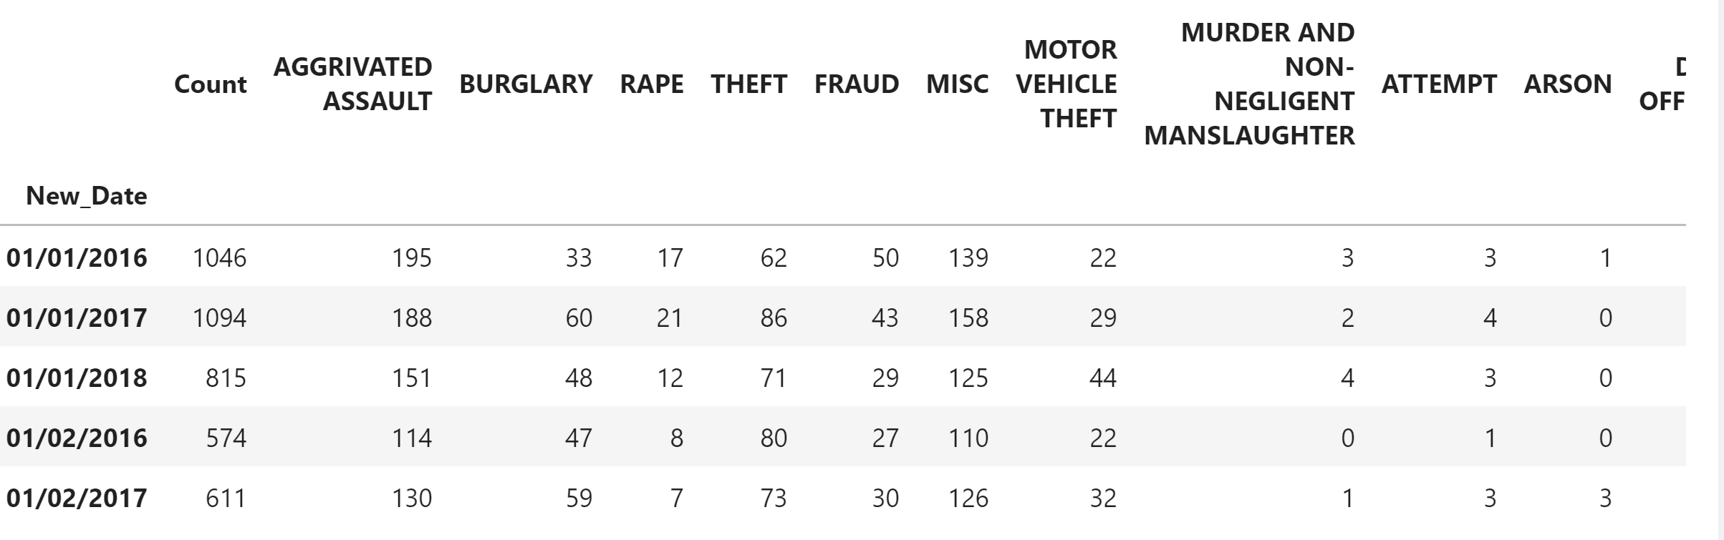
Sample Scrubbed Data set

Slide 7
Is there an increase in crime during major shopping holidays?
Rusty Gentile

Slide 8
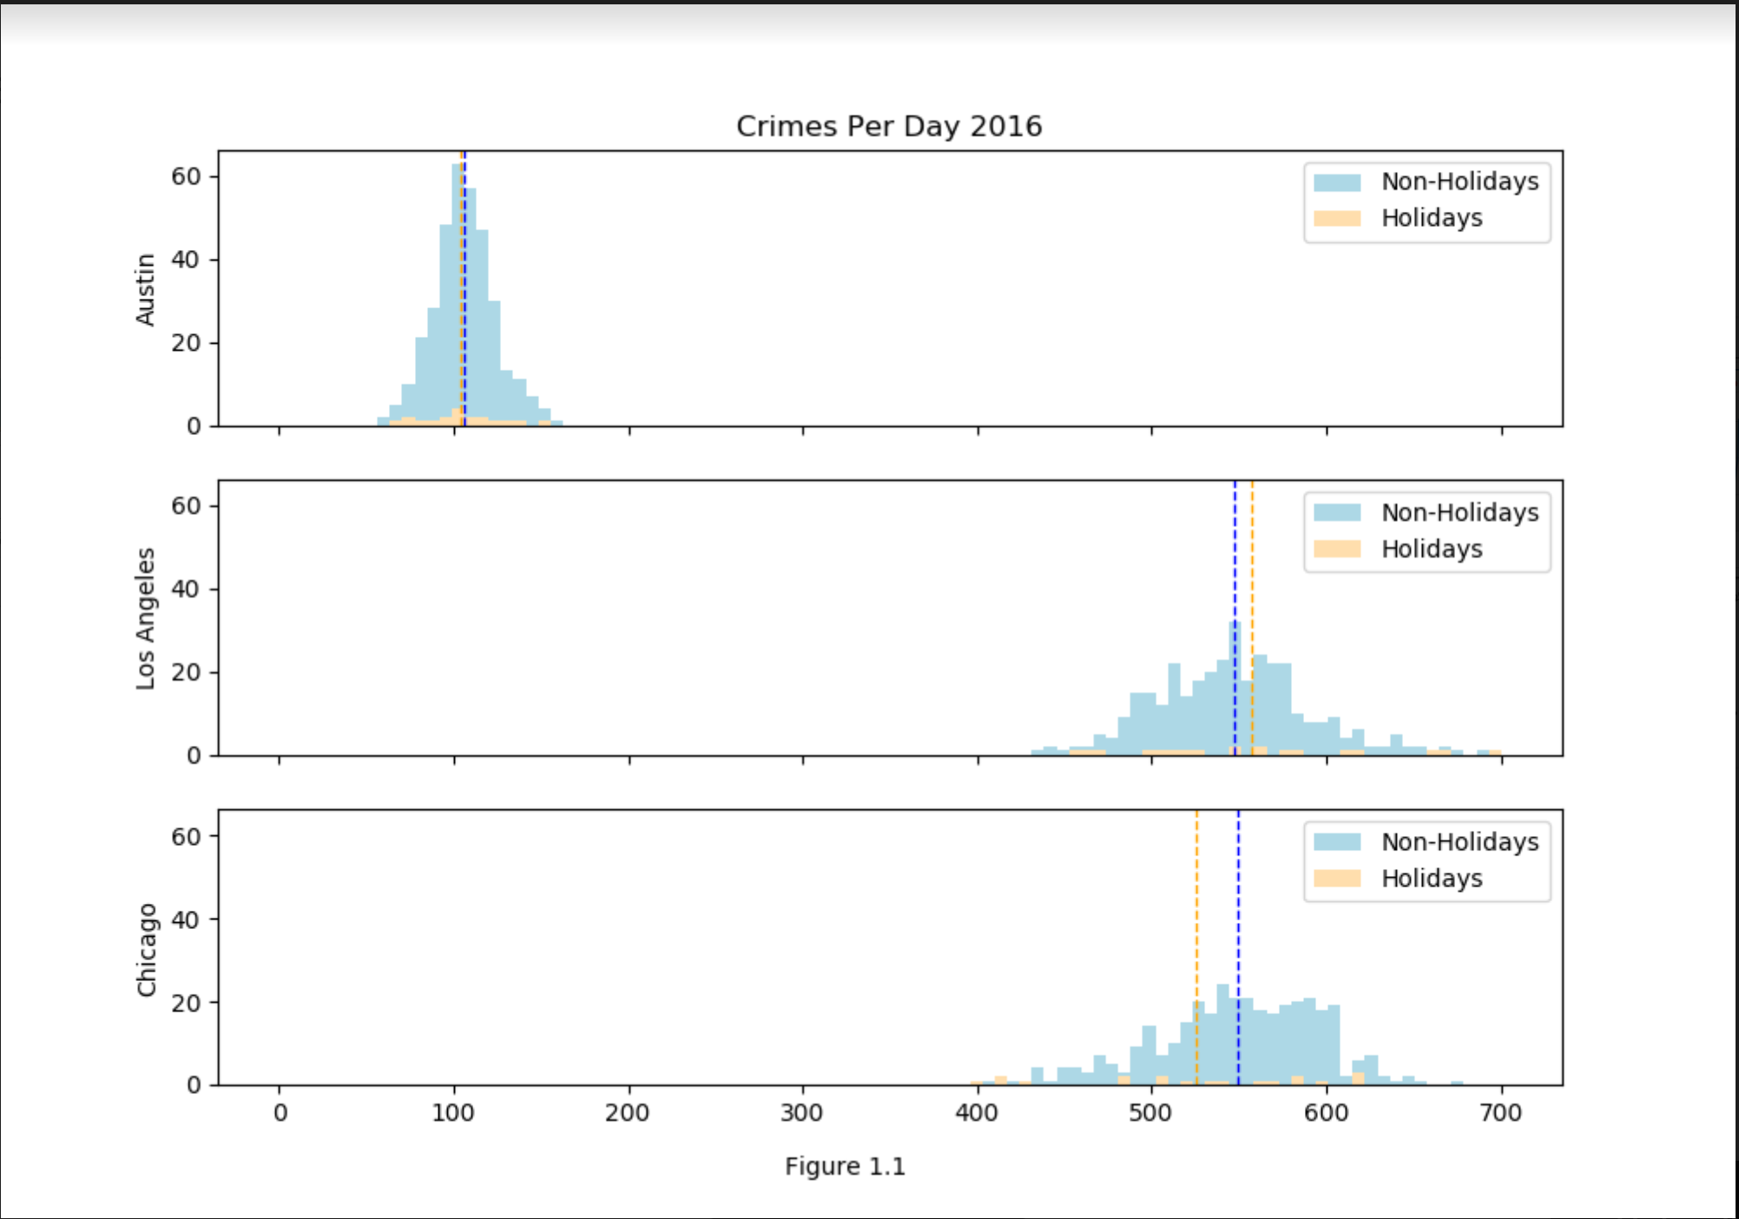
FIG 1.1
4.43% decrease in crime on holidays
@P = 3.84%

Slide 9
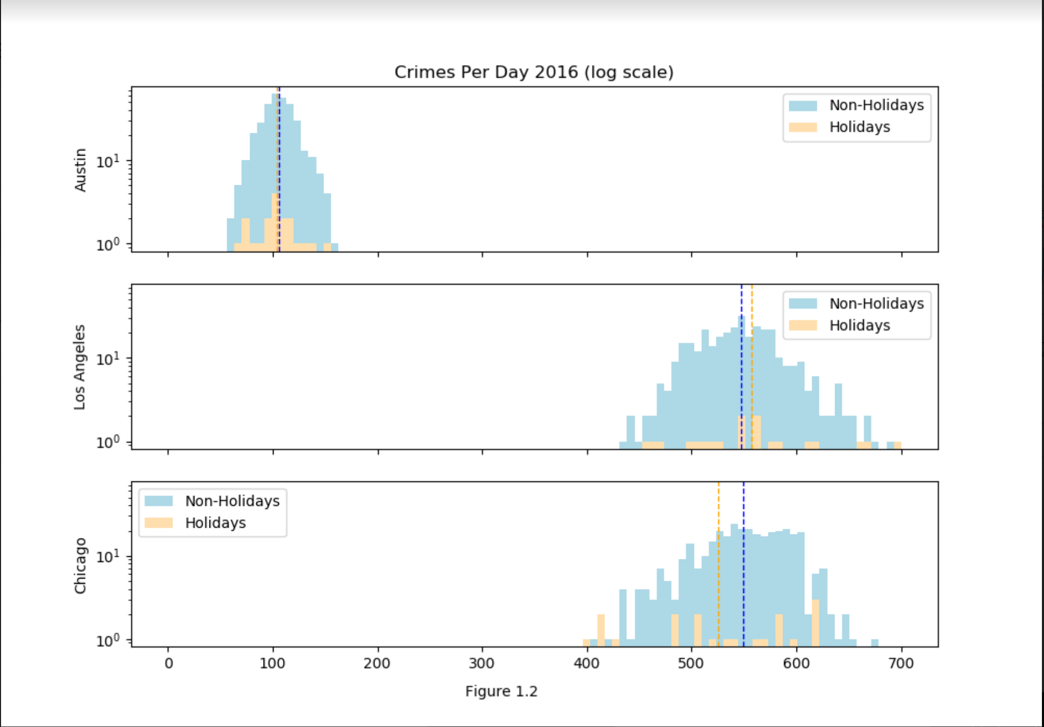
FIG 1.2

Slide 10
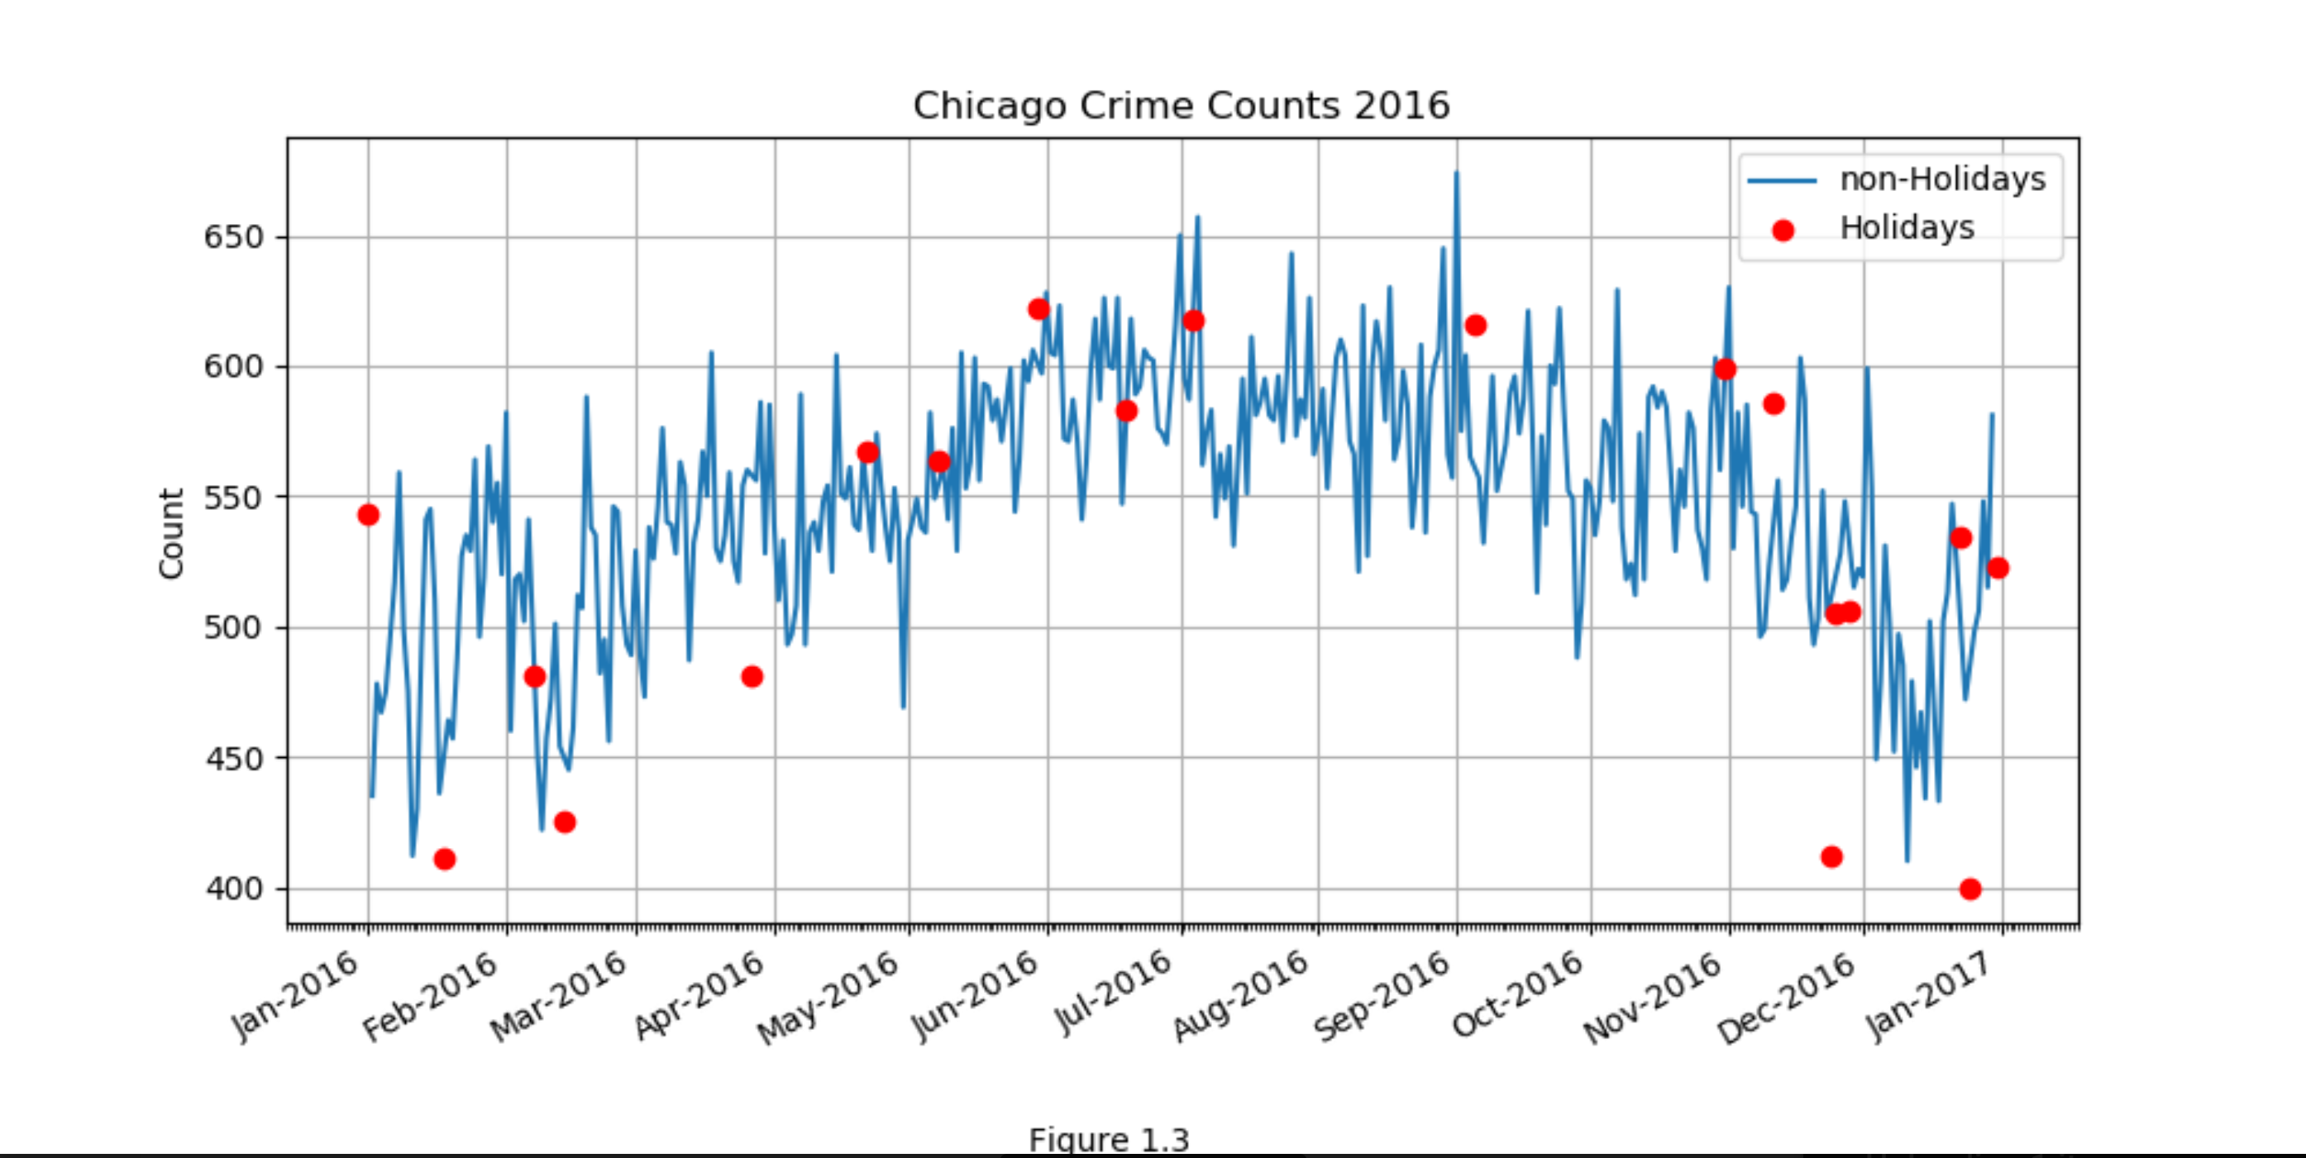
FIG 1.3
Possible seasonal affect on crime rates. I.e more crimes committed in the summer.

Slide 11
Do cities with the least amount of crime experience an increase in crime that is more than noticeable during major shopping holidays?
Scott Nubar

Slide 12
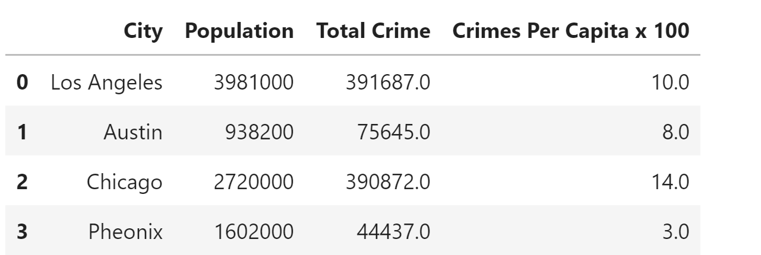
Population & Total Crimes vs.
Crimes per Capita

Slide 13
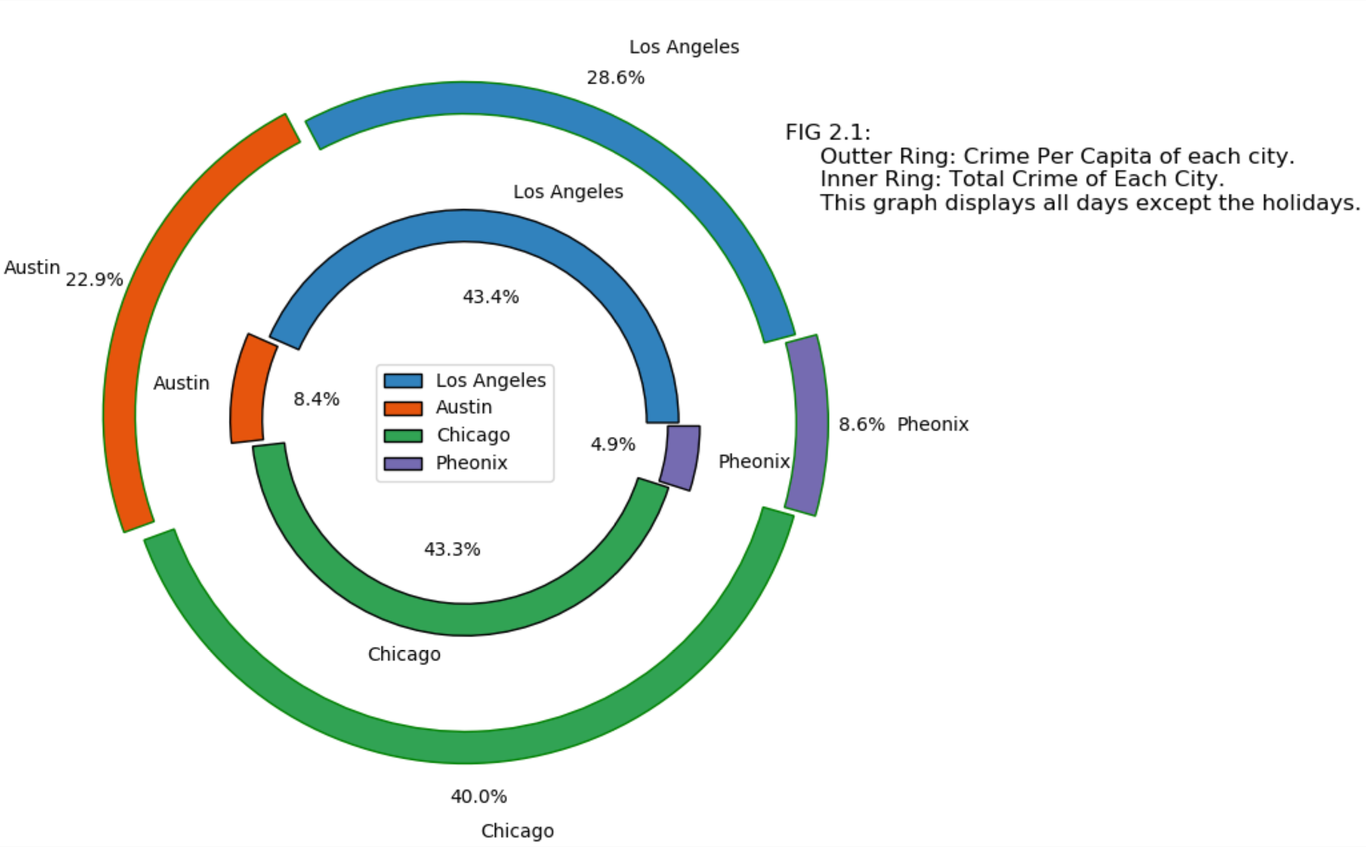
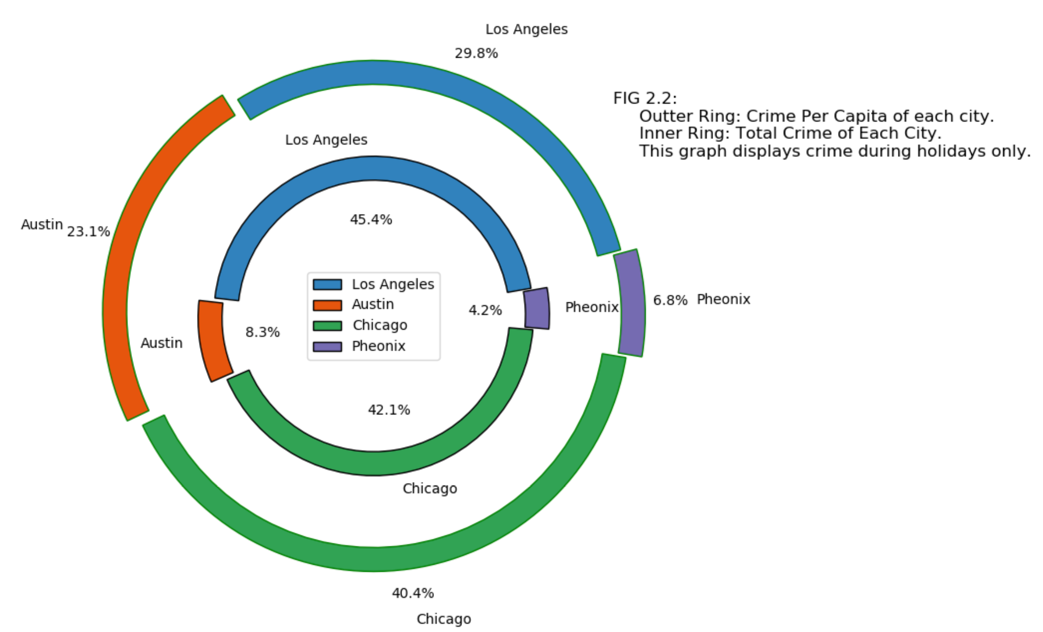
FIG 2.2
FIG 2.1

Slide 14
Which holiday does crime more frequently occur?
Minal Jajoo

Slide 15
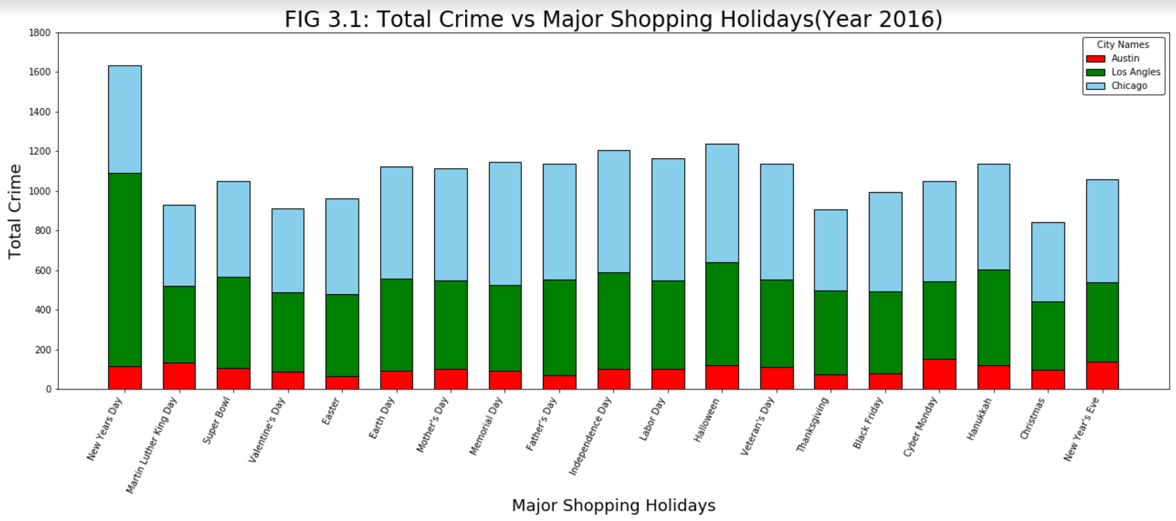
FIG 3.1

Slide 16
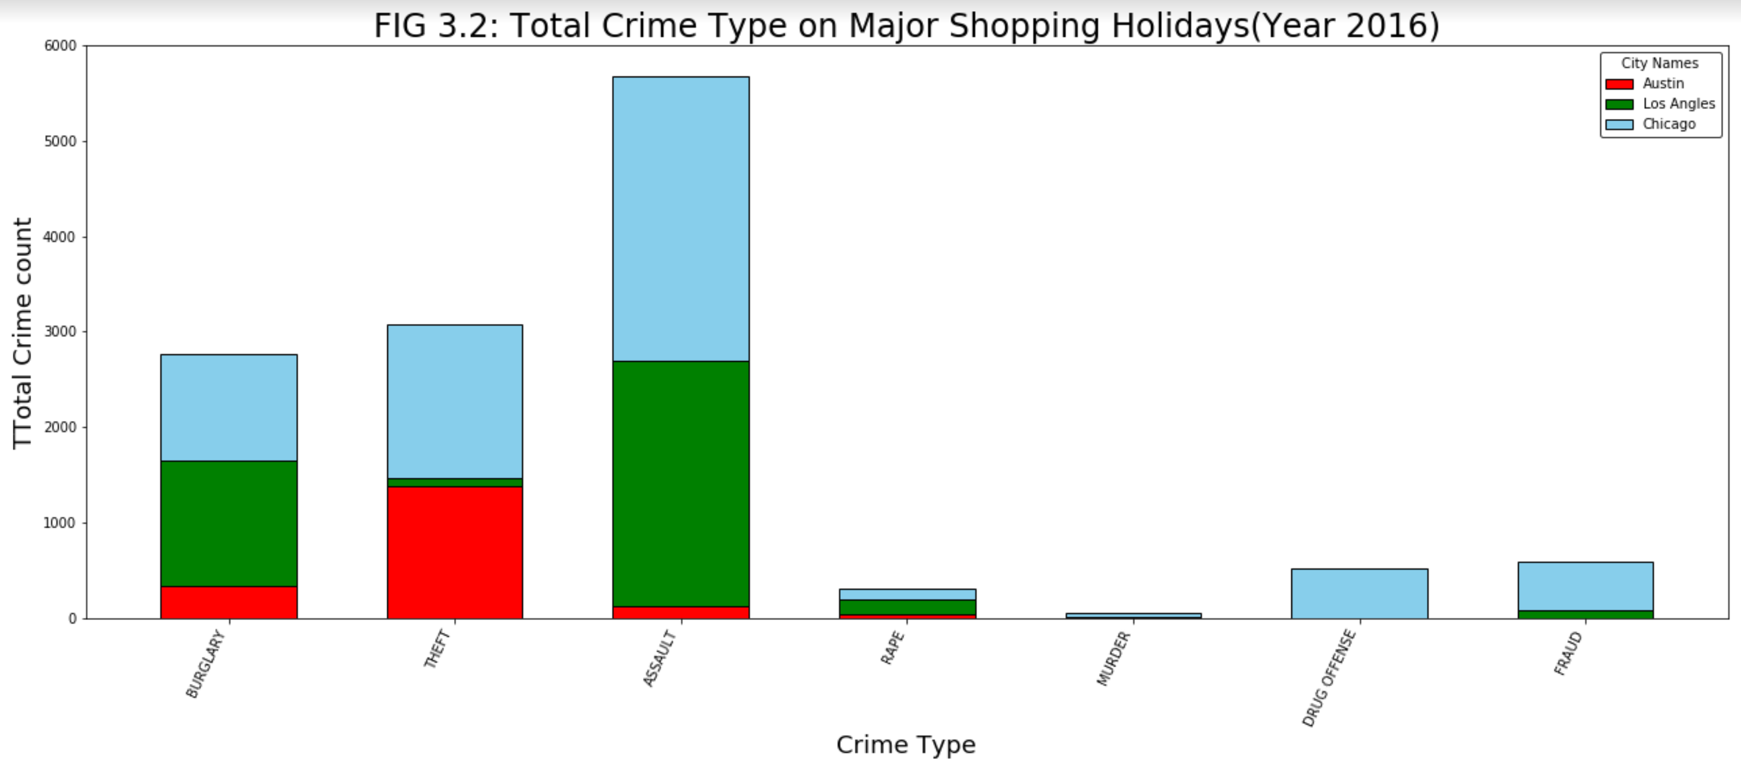
FIG 3.2

Slide 17
Do the holidays have an impact on crime location?
Axander Wilson

Slide 18
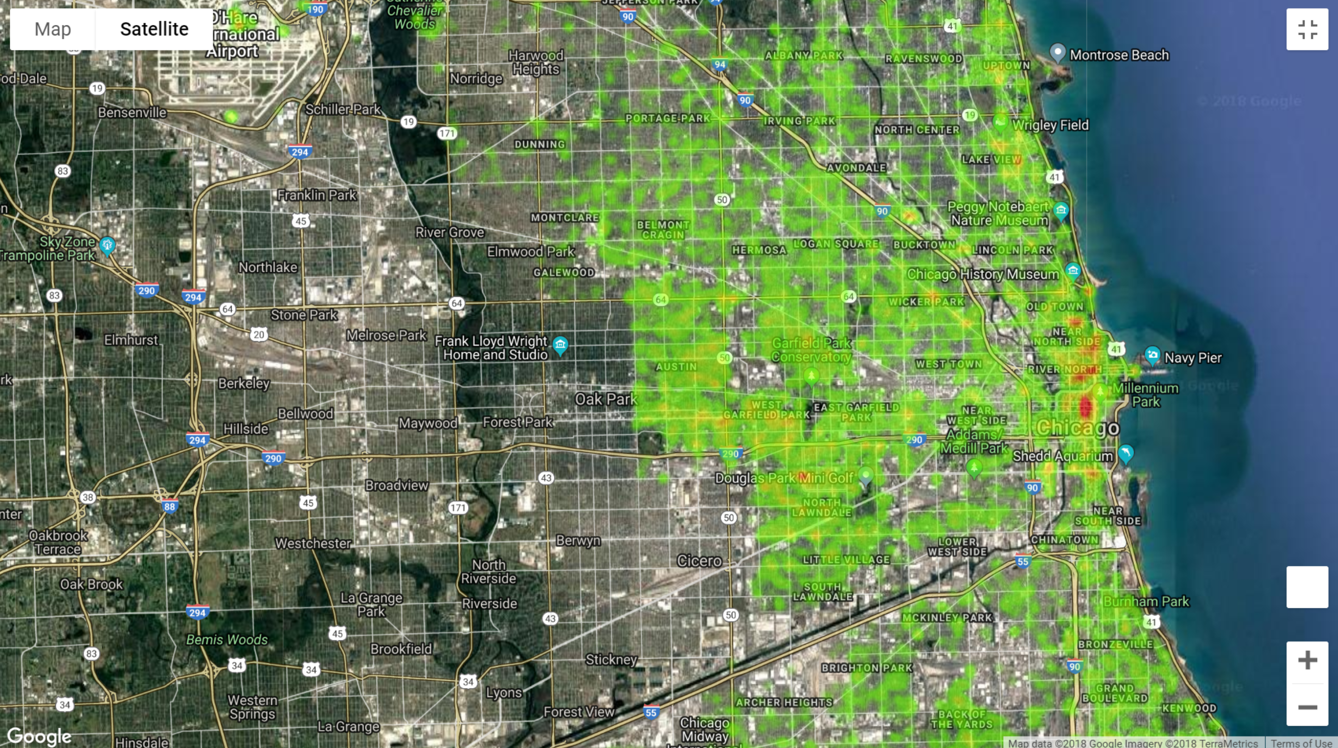
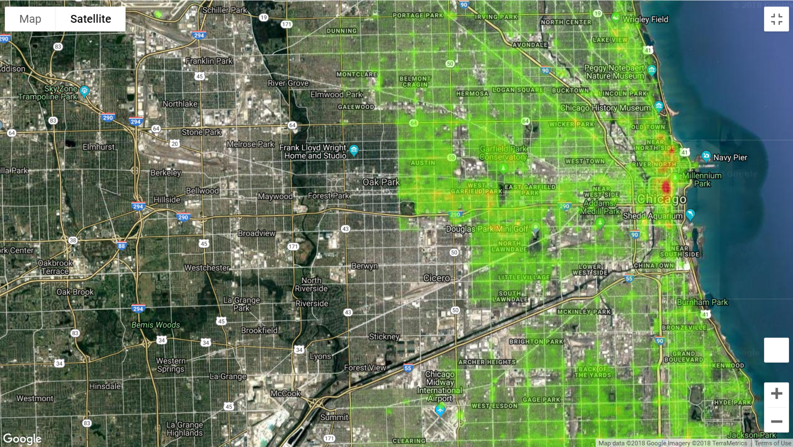
Chicago Heat Map
Non – Holiday
Holiday

Slide 19

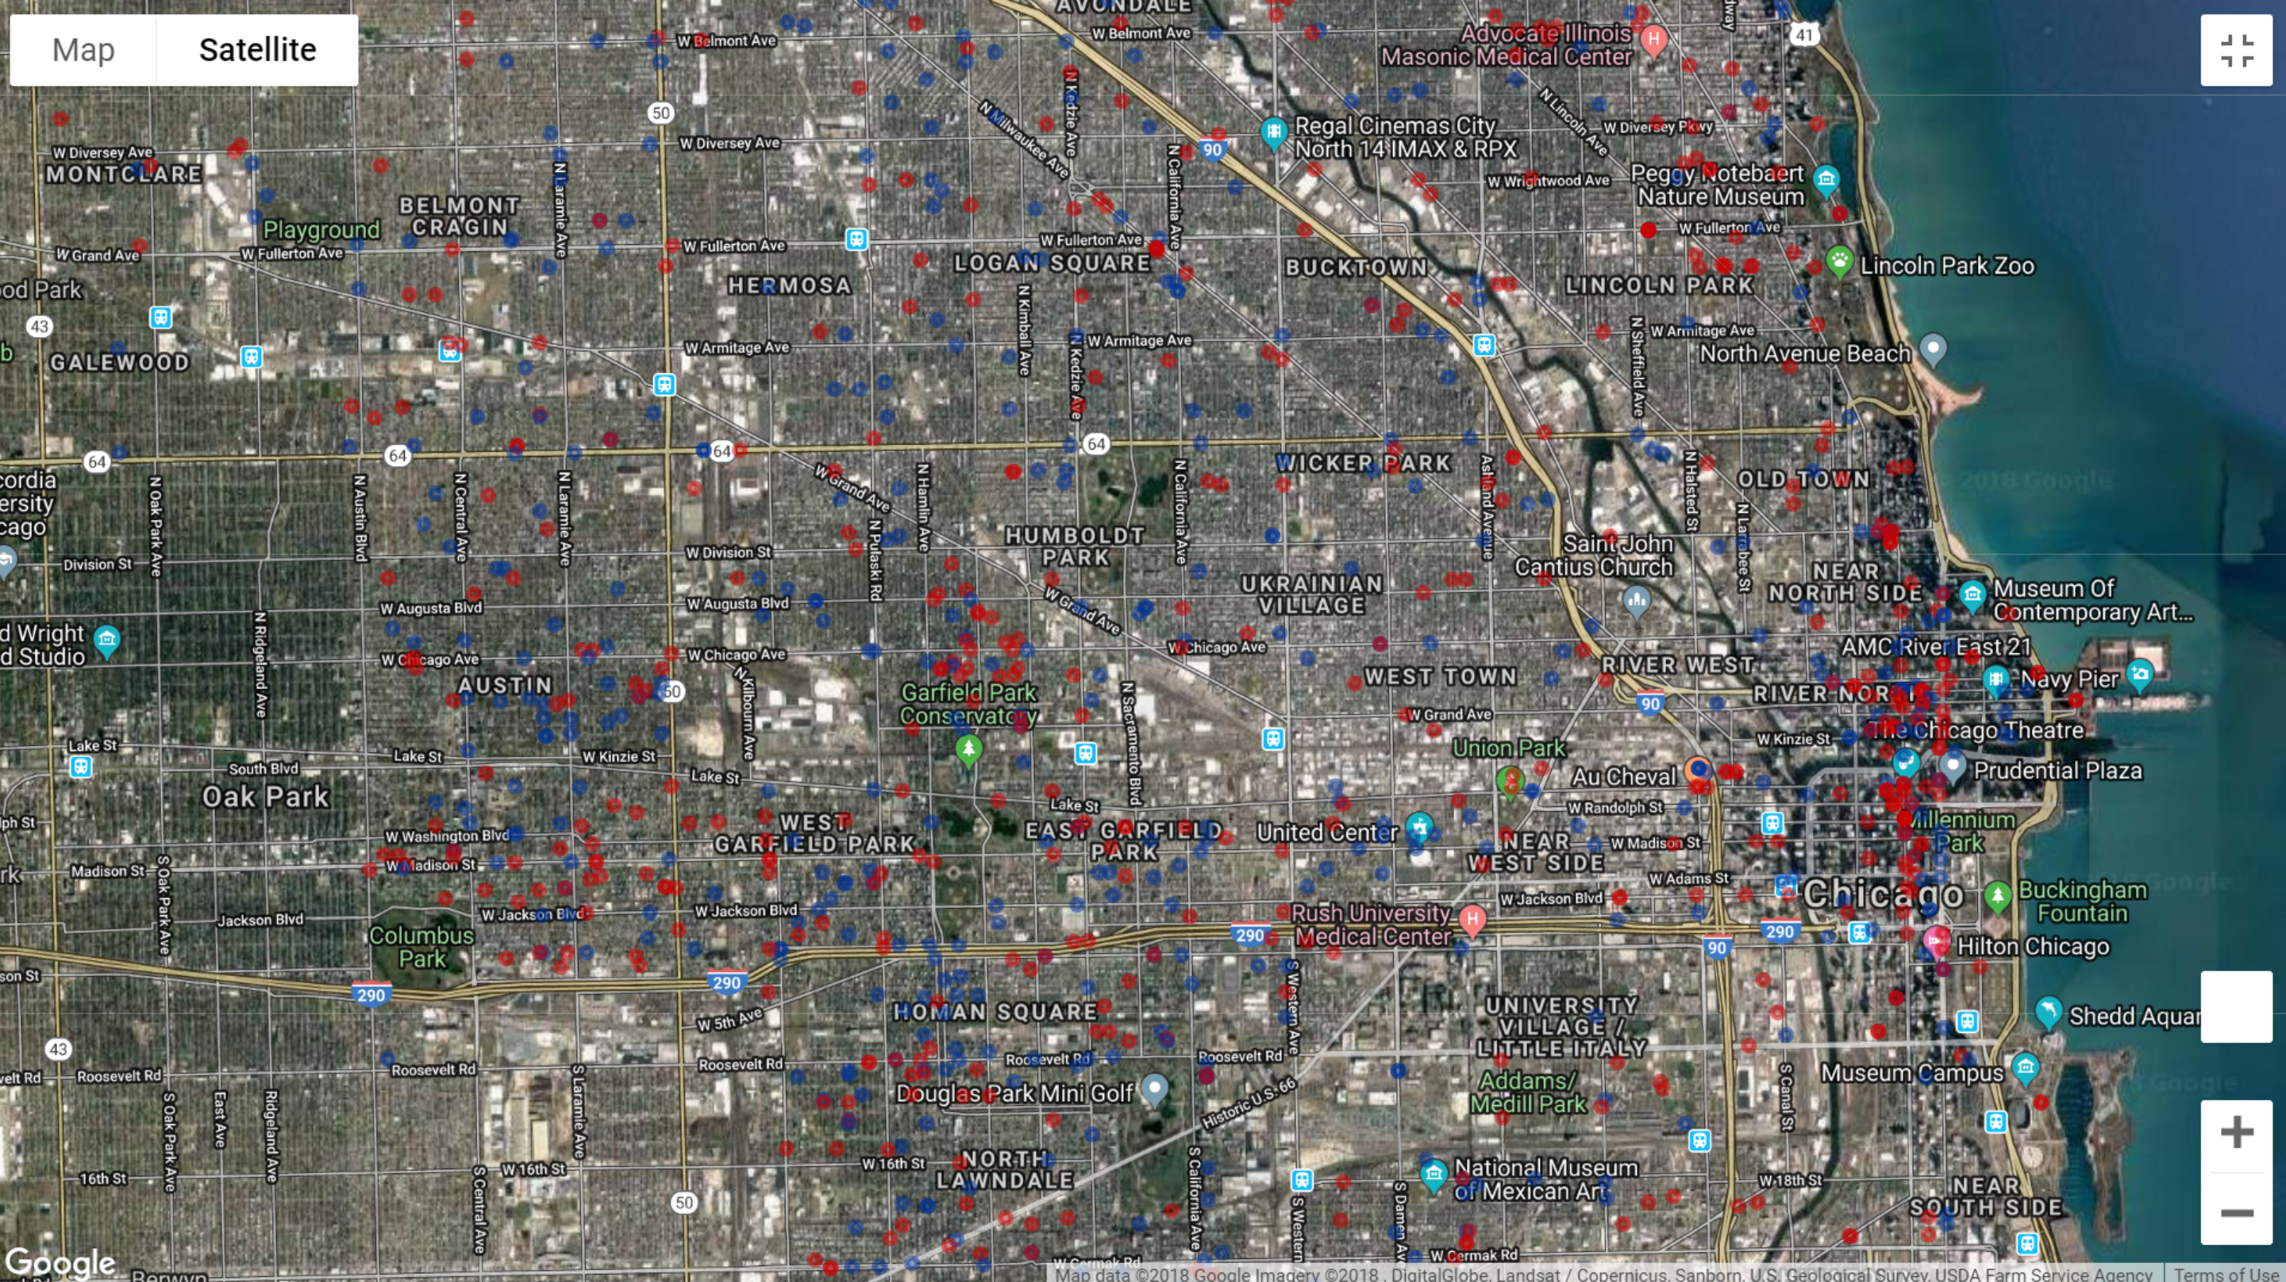

Slide 20
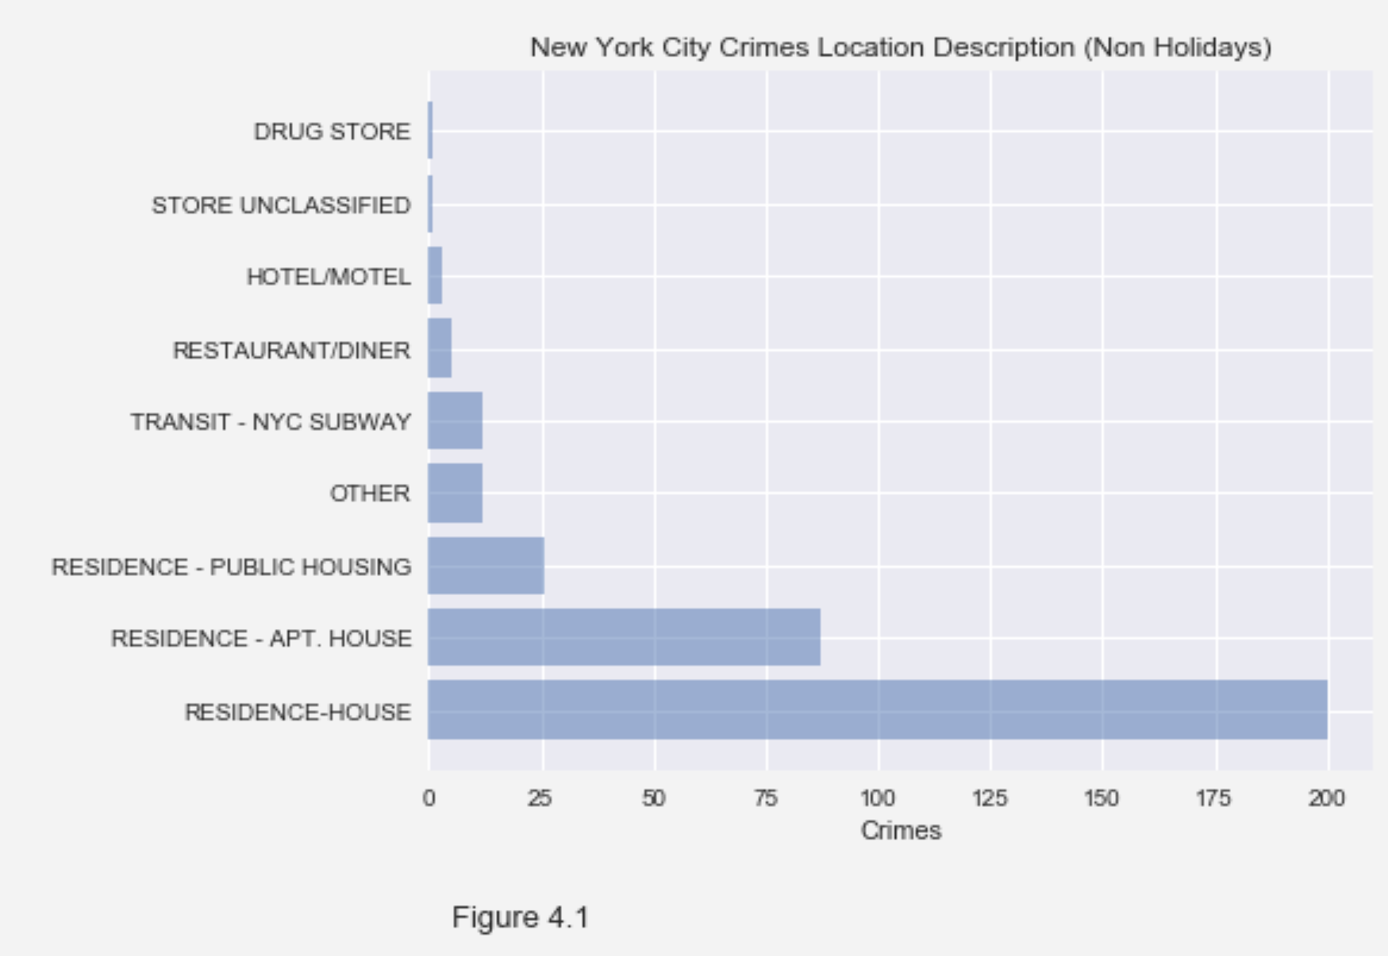
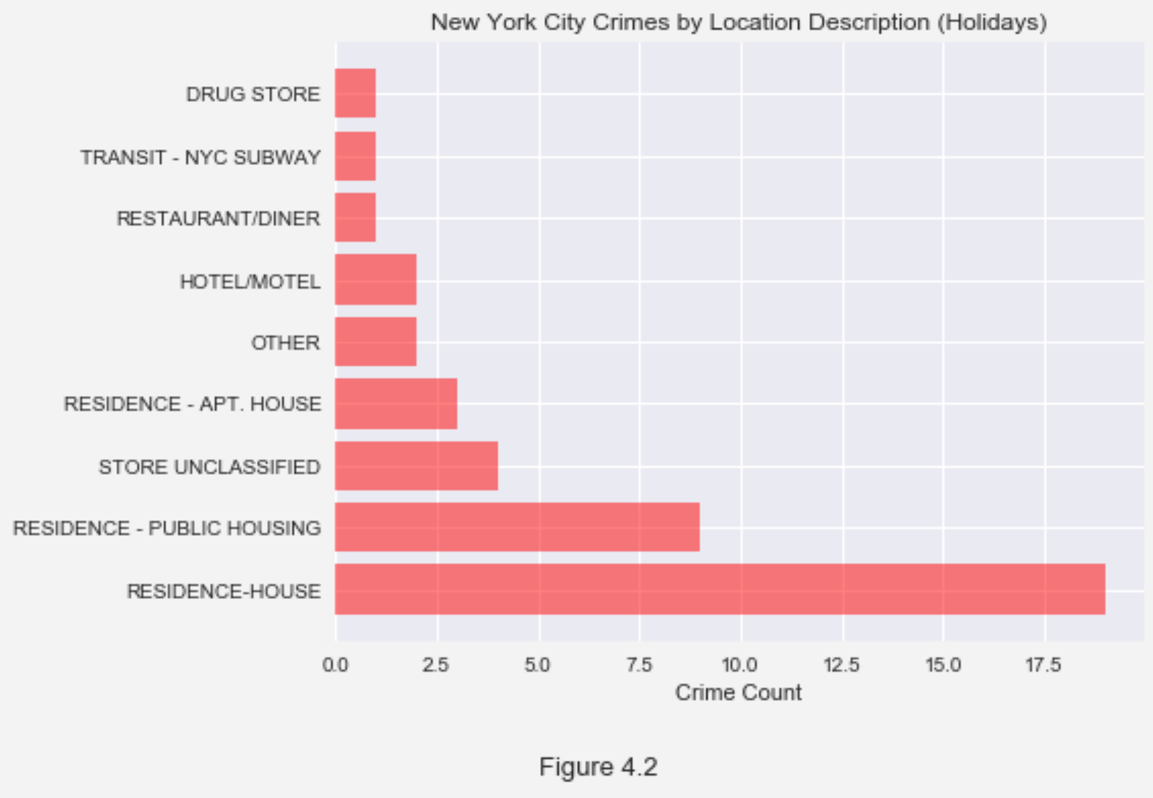
FIG 4.1& FIG 4.2

Slide 21
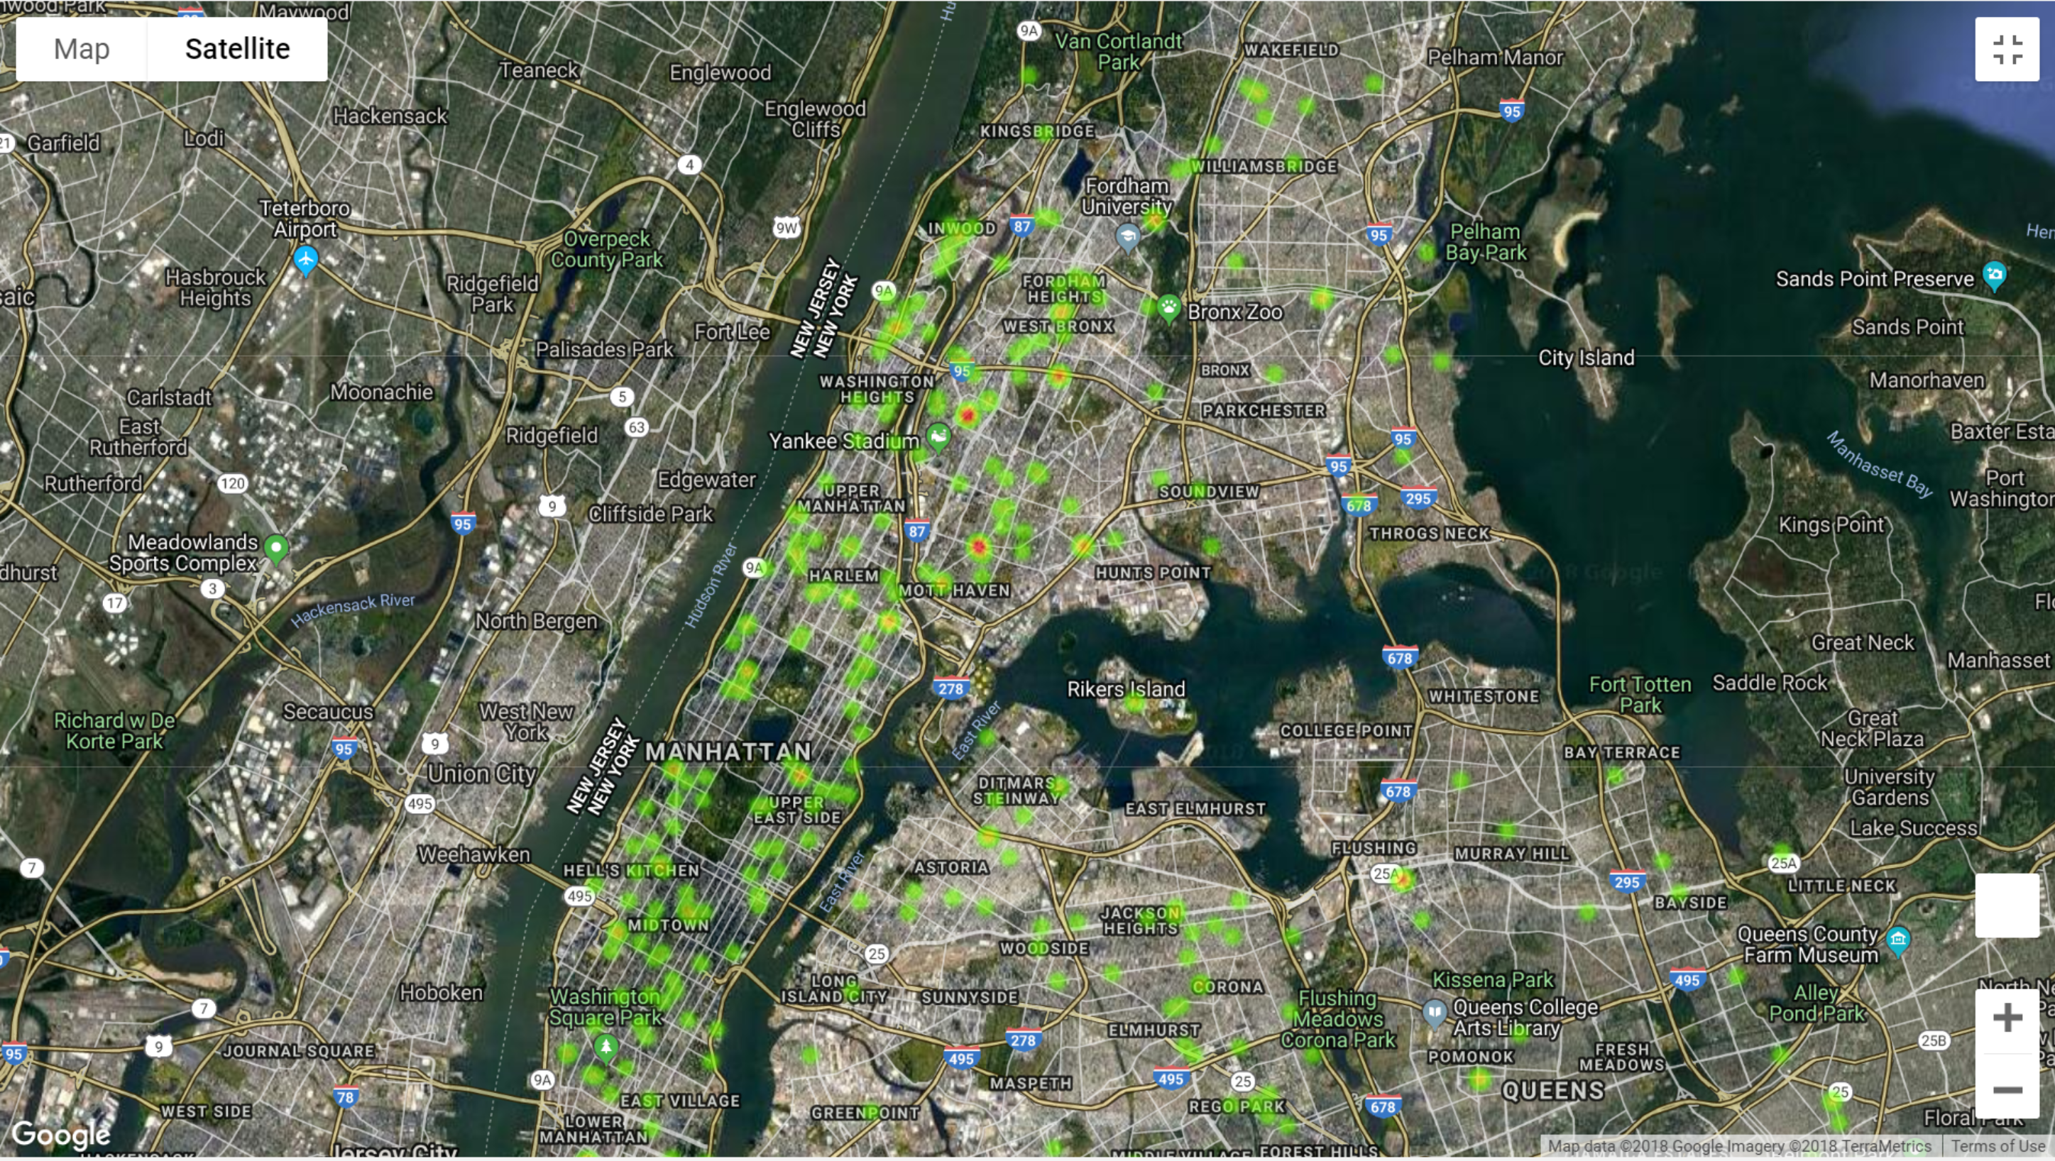
New York Heat Map

Slide 22
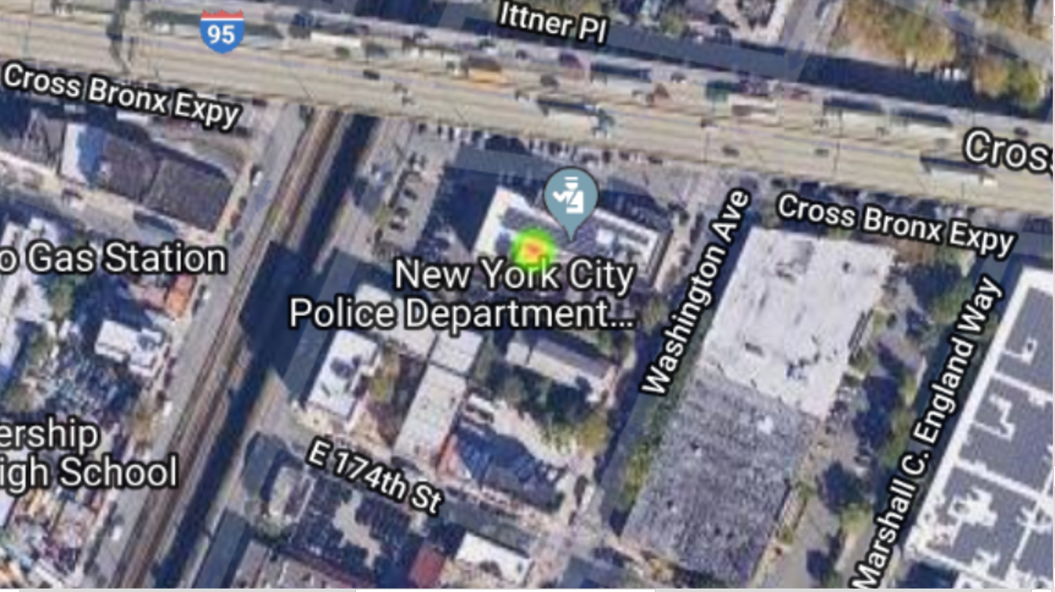

Slide 23
Conclusion
Given our data set we were not able to prove if there was any correlation between an increase in crime during major shopping holidays.
T Austin = -0.573
T Austin = 56.7%
T LA = 0.8958879334012444
P LA = 37.1 %
T Chicago: -2.078106931167499
P Chicago: 3.84%
Chicago average difference: -23.8 crimes per day
Chicago average % difference: -4.43 %

Slide 24
Errors in Data Analysis
Variable Types when merging data frames for all cities.
Inconsistent categories between cities. Some has hundreds.
Struggles with heat map

Slide 25
Questions?

